Slide 1
Confirmatory Factor Analysis

Slide 2
Today . . .
  Variance of an item
  Identifiability
  Goodness of fit indices
  A CFA example

Slide 3

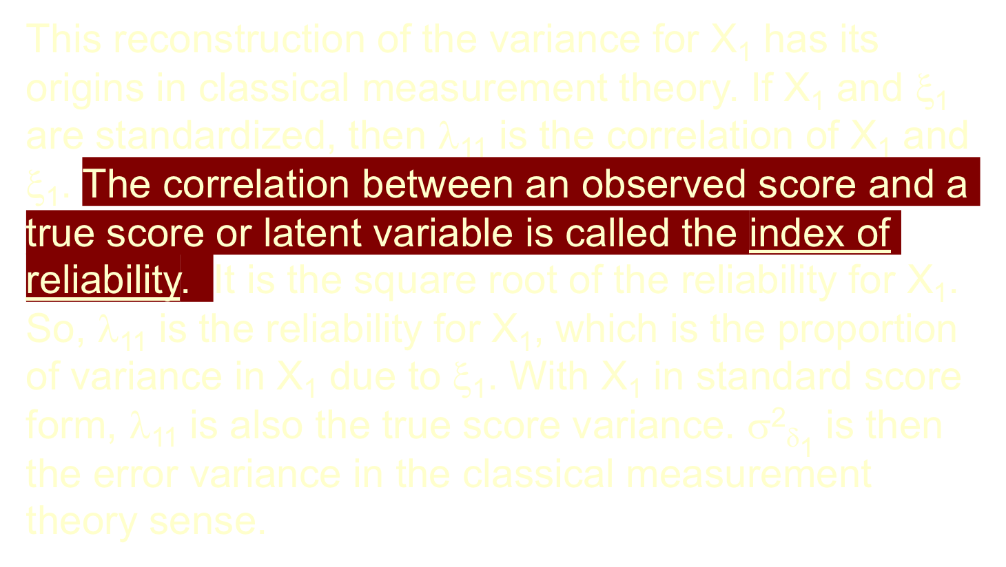
2
2

Slide 4
The “Identification Problem”
Identification means that there is sufficient information in the data and model to provide unique estimation of the free parameters. Identification is obtained by restricting the model in some way.
Example: There are an infinite number of solutions to the “model”: X + Y = 15. A unique solution can only be found by restricting the model in some way. If X is restricted to equal 5, then the unique solution for Y is 10. Likewise an equality constraint, X = Y, provides for a unique solution.

Slide 5
Similarly, and with greater complexity, confirmatory factor models must have a sufficient number of restrictions before the parameters can be estimated uniquely.
Note how this is different compared to exploratory factor analysis. We impose no constraints in EFA and there are an infinite number of acceptable solutions (i.e., rotations).
In CFA, models are restricted by either forcing some parameters to specific values (usually 0 or 1) or constraining some parameters to be equal to other parameters.

Slide 6
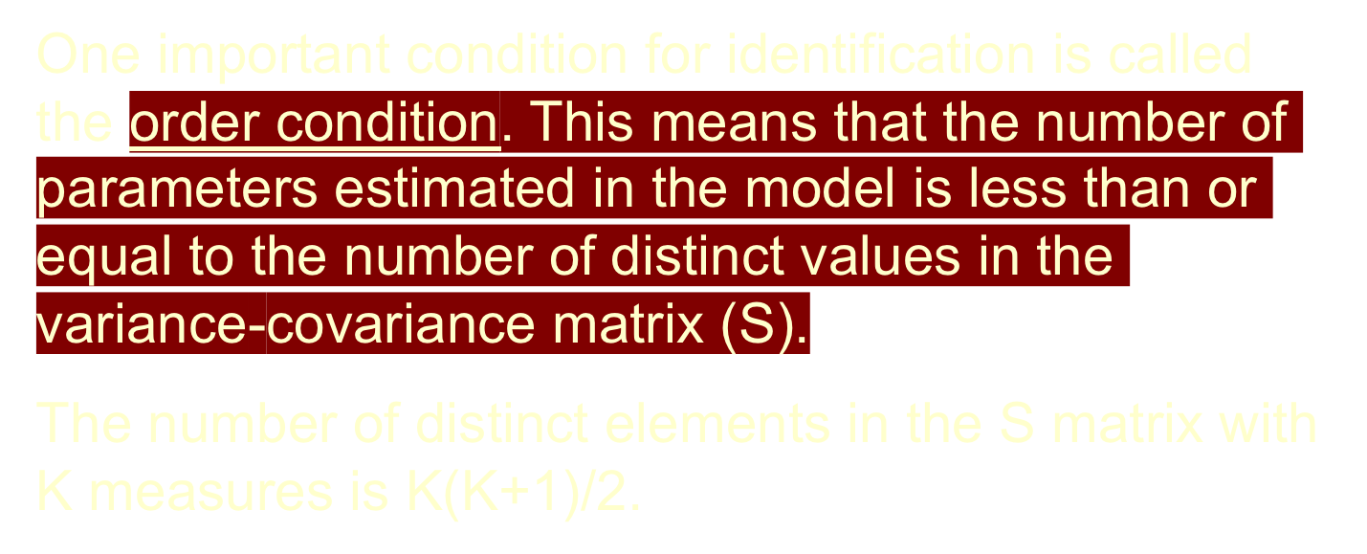

Slide 7
Depending on the number of estimated parameters relative to the number of known values (number of unique elements in the variance-covariance matrix):
  Over-identified models (degrees of freedom > 0)
  Just-identified models (0 degrees of freedom; trivial perfect fit)
  Under-identified models (cannot be estimated)
Notes:
When measurement models are combined with structural models, identification becomes more difficult to establish.

Slide 8
Goodness of fit
  Absolute indices
  Comparative indices
  Parsimony indices

Slide 9
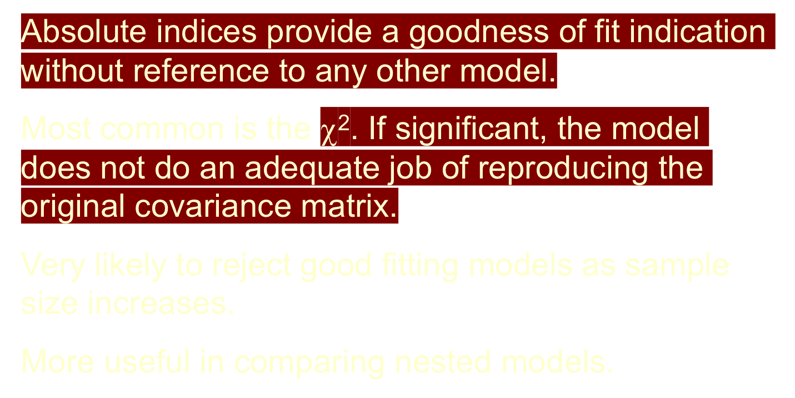

Slide 10
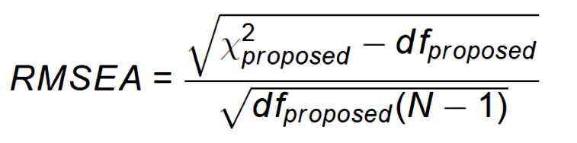
Root Mean Square Error of Approximation:
A close fitting model < .05
Confidence intervals can be placed around RMSEA and provide an estimate of uncertainty.
“Probability of close fit” is often reported and should be greater than .05, preferably much greater.

Slide 11
Standardized Root Mean Residual (SRMR):
SRMR = mean difference between the observed
correlations and the predicted
correlations (Σ compared to S).
A close fitting model < .08.

Slide 12
Comparative fit indices provide a goodness of fit indication with reference to another model, most commonly (by default) the null model.
The null model is not usually a compelling alternative. It is usually defined as assuming all correlations among variables are zero.

Slide 13
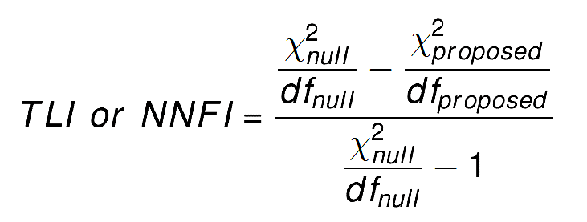
Tucker-Lewis (Non-Normed Fit) Index:
A good fitting model > .95

Slide 14
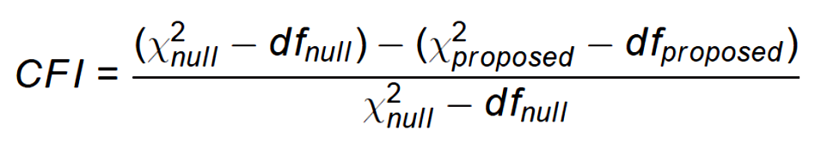
Comparative Fit Index:
A good fitting model > .95

Slide 15
Parsimony fit indices take model complexity into account in much the same way as the adjusted R² in multiple regression.
These are less commonly reported.

Slide 16
The confirmatory approach begins with an explicit model that implies the elements of the key matrices. Some of these parameters are assumed to be fixed (usually at 0 or 1), some are freely estimated, and some may be constrained (e.g., to be equal to other parameters).
These expectations are then built into the model estimation.
Hypothetical data (N = 500) were created for individuals completing a 12-section test of mental abilities. All variables are in standard form.

Slide 17
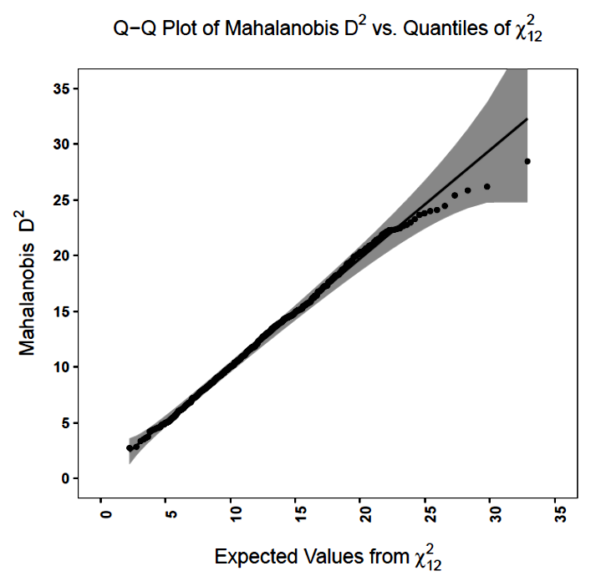
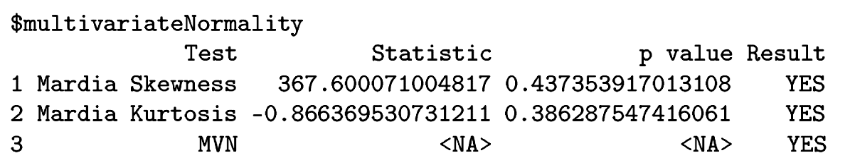
No extreme outliers. The data are multivariate normal.

Slide 18
Verbal
Math
Analytic
δ₁
δ₂
δ₃
δ₄
δ₅
δ₆
δ₇
δ₈
δ₉
δ₁₀
δ₁₁
δ₁₂

Slide 19
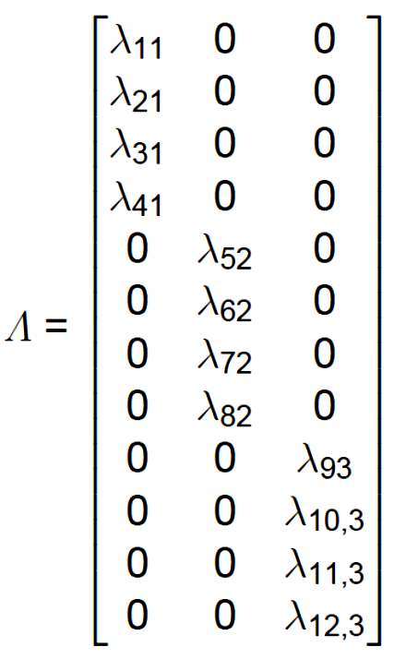
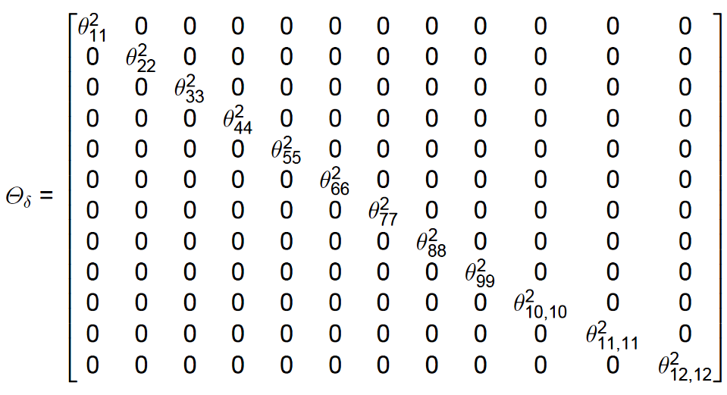
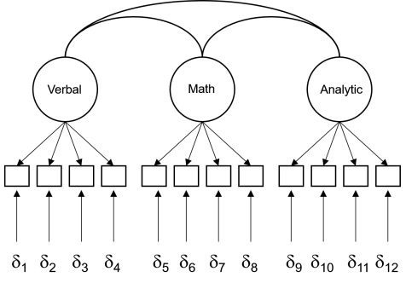
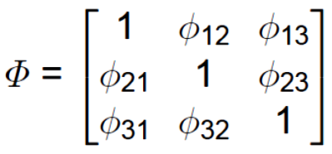
The model implies quite a few fixed parameters.

Slide 20
The lavaan package can be used to conduct confirmatory factor analyses (in addition to SEM). It requires specifying a model using simple operators (e.f., =~, ~~) and a few simple rules and defaults.
mental.model.1 <- ‘
Verbal =~ Grammar + Paragraph_Comprehension + Vocabulary +
Sentence_Completion
Math =~ Geometry + Algebra + Numerical_Puzzles +
Series_Completion
Reasoning =~ Practical_Problem_Solving + Symbol_Manipulation
+ Analytical_Ability + Formal_Logic
Verbal ~~ Math
Verbal ~~ Reasoning
Math ~~ Reasoning
'
CFA_Fit_1 <- cfa(mental.model.1, data = Mental, missing="ML", estimator="MLR",likelihood="wishart",representation="LISREL")
summary(CFA_Fit_1, standardized=TRUE,rsq=TRUE,fit.measures = TRUE)

Slide 21
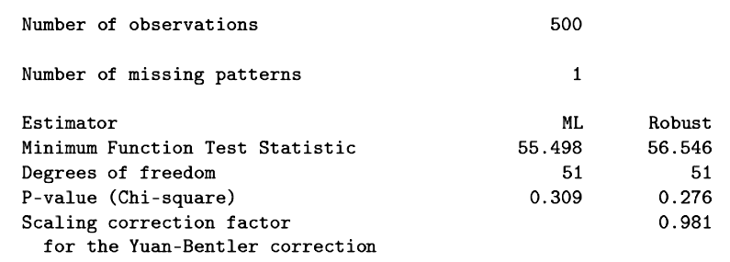
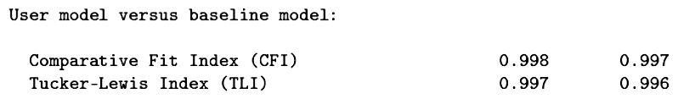
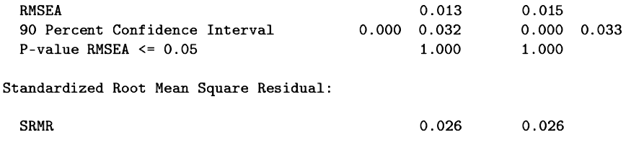

Slide 22
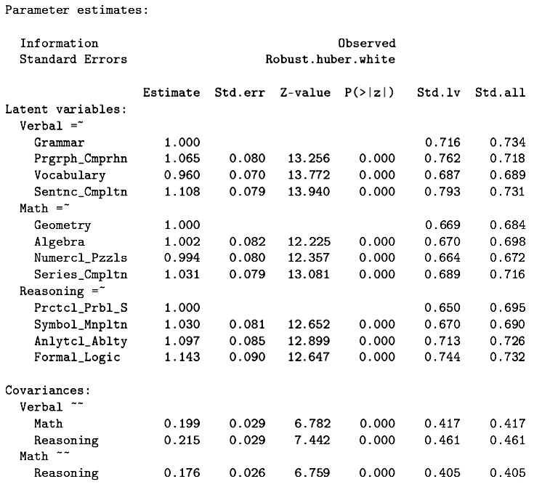

Slide 23
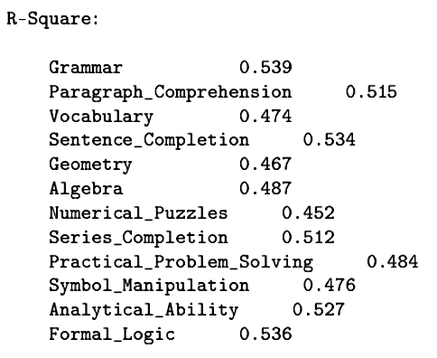
The R-Square reported by lavaan is the proportion of variance in each variable accounted for by the model. Sound familiar?

Slide 24
The chosen model fits the data quite well. How would other models do?
A complete confirmatory analysis would not only test the preferred model but also examine alternative models to assess how easily they could account for the data.
To the extent that reasonable alternatives exist, the preferred model must be considered with more caution.

Slide 25
Other models can easily be tested.
Verbal
Math
Analytic
δ₁
δ₂
δ₃
δ₄
δ₅
δ₆
δ₇
δ₈
δ₉
δ₁₀
δ₁₁
δ₁₂

Slide 26
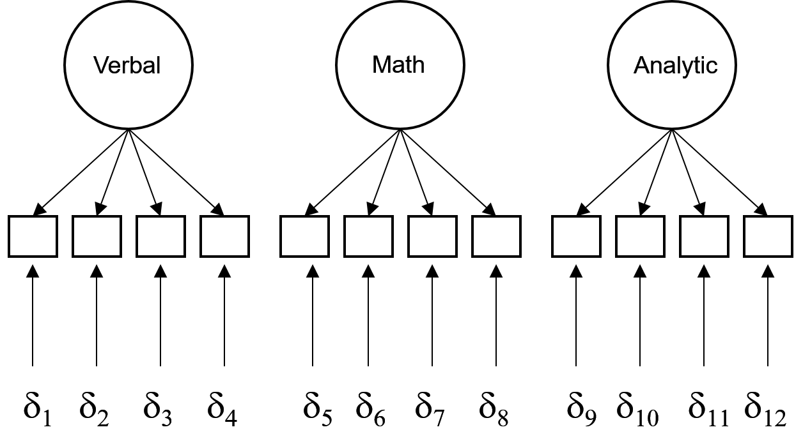
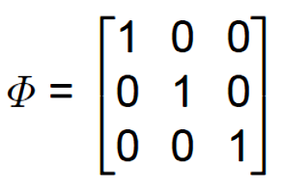

Slide 27
mental.model.2 <- '
Verbal =~ Grammar + Paragraph_Comprehension + Vocabulary +
Sentence_Completion
Math =~ Geometry + Algebra + Numerical_Puzzles +
Series_Completion
Reasoning =~ Practical_Problem_Solving + Symbol_Manipulation
+ Analytical_Ability + Formal_Logic
Verbal ~~ 0*Math
Verbal ~~ 0*Reasoning
Math ~~ 0*Reasoning
'

Slide 28
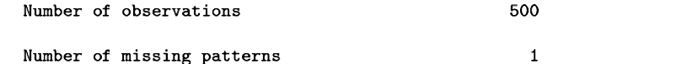
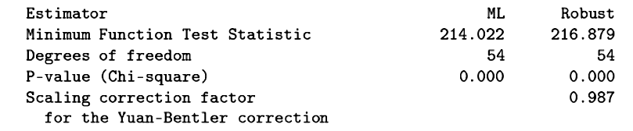
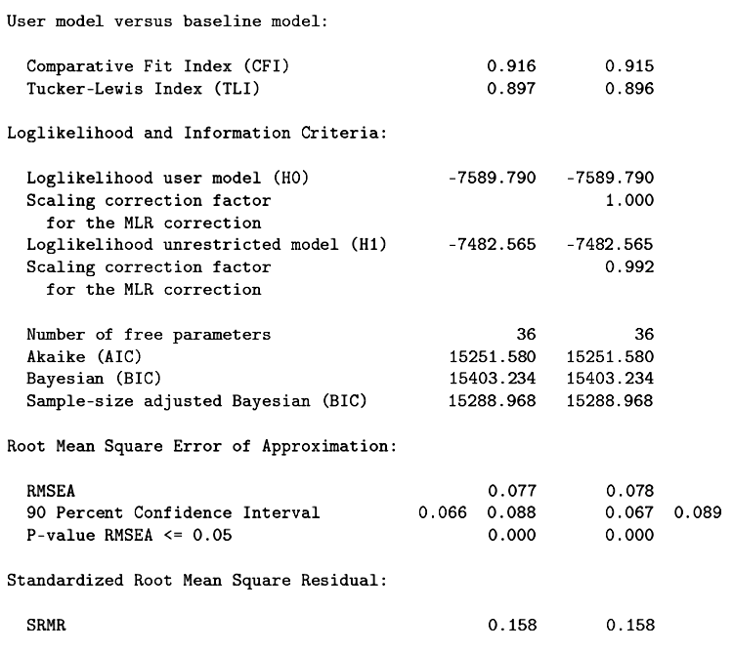

Slide 29
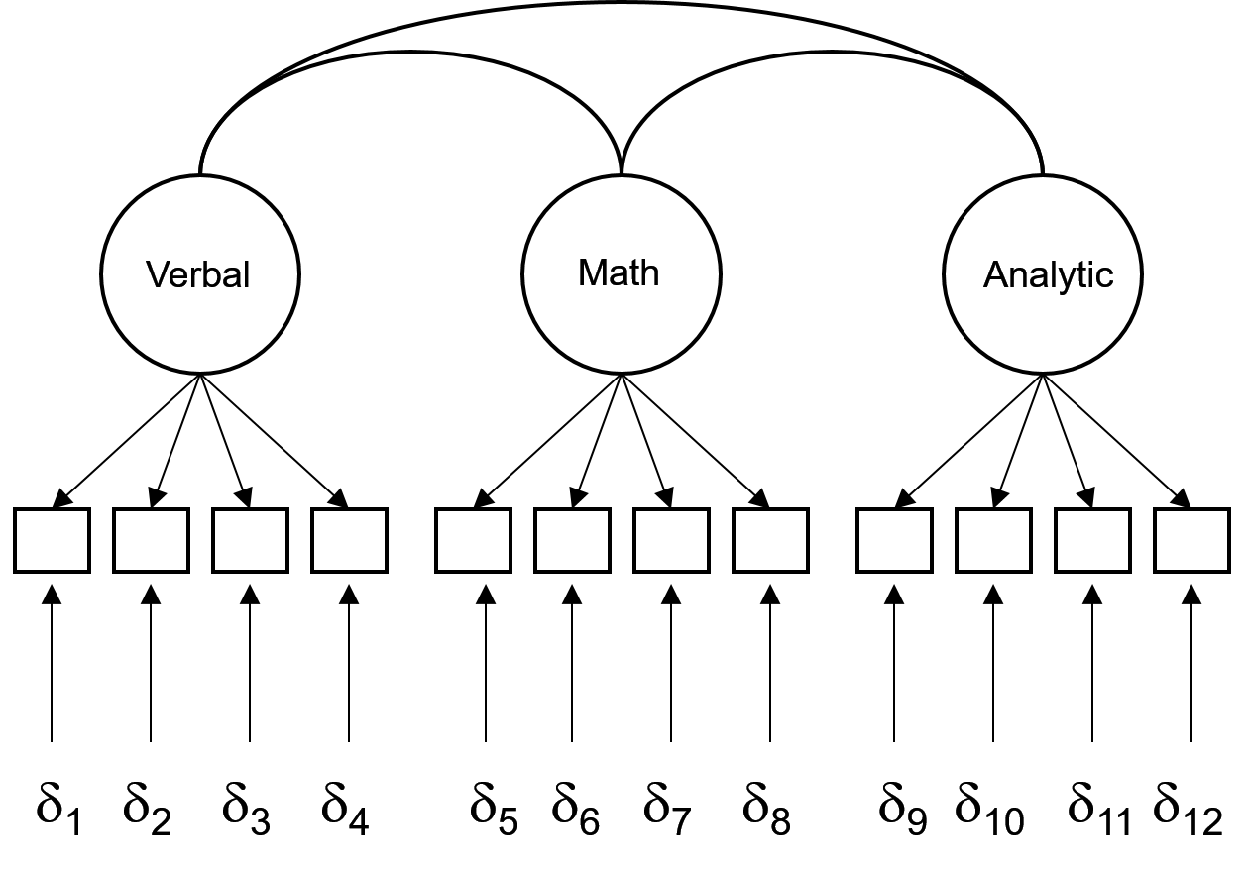
Is one model a better fit than the other?
When models are nested, the difference in their chi-square tests is also chi-square distributed, with degrees of freedom equal to the difference in degrees of freedom. Models are nested when constraining one will produce the other.

Slide 30
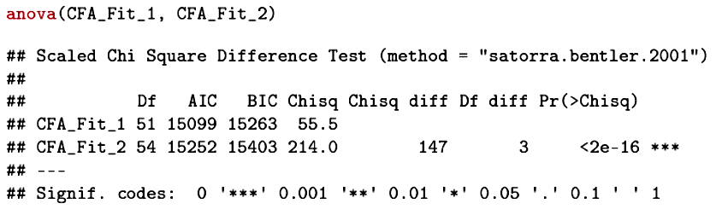
By constraining the latent variable correlations to 0, we produce a model that is a significantly worse fit than the original model.

Slide 31
Ability
δ₁
δ₂
δ₃
δ₄
δ₅
δ₆
δ₇
δ₈
δ₉
δ₁₀
δ₁₁
δ₁₂

Slide 32
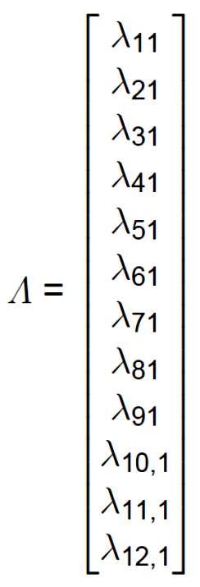
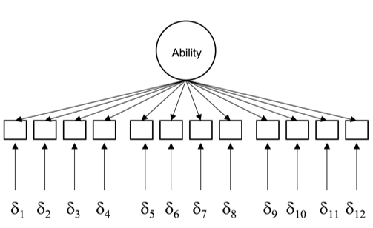


Slide 33
mental.model.3 <- '
Ability =~ Grammar + Paragraph_Comprehension Vocabulary +
Sentence_Completion + Geometry + Algebra +
Numerical_Puzzles+Series_Completion +
Practical_Problem_Solving + Symbol_Manipulation +
Analytical_Ability + Formal_Logic
'

Slide 34
mental.model.3b <- '
Verbal =~ NA*Grammar + Paragraph_Comprehension + Vocabulary
+ Sentence_Completion
Math =~ NA*Geometry + Algebra + Numerical_Puzzles +
Series_Completion
Reasoning =~ NA*Practical_Problem_Solving +
Symbol_Manipulation + Analytical_Ability +
Formal_Logic
Verbal ~~ 1*Math
Verbal ~~ 1*Reasoning
Math ~~ 1*Reasoning
Verbal ~~ 1*Verbal
Math ~~ 1*Math
Reasoning ~~ 1*Reasoning
'
This model will produce identical results and shows that it is a constrained version of the first model and so a nested model comparison is possible.

Slide 35
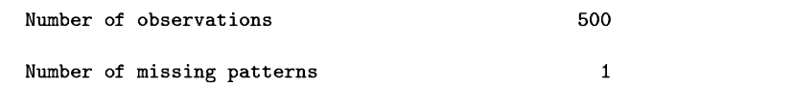
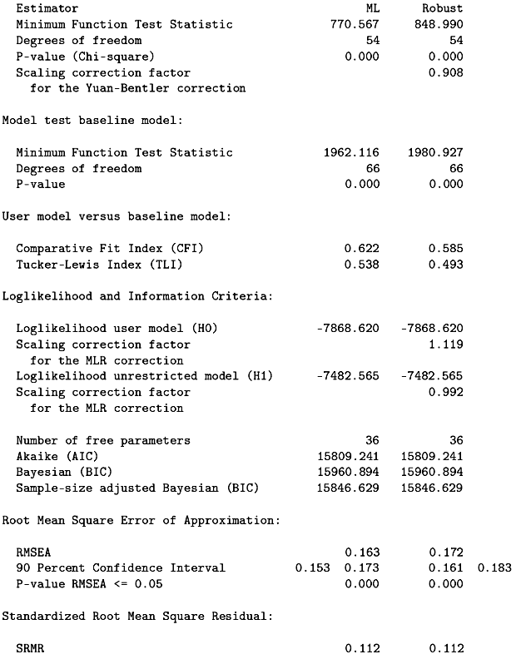

Slide 36


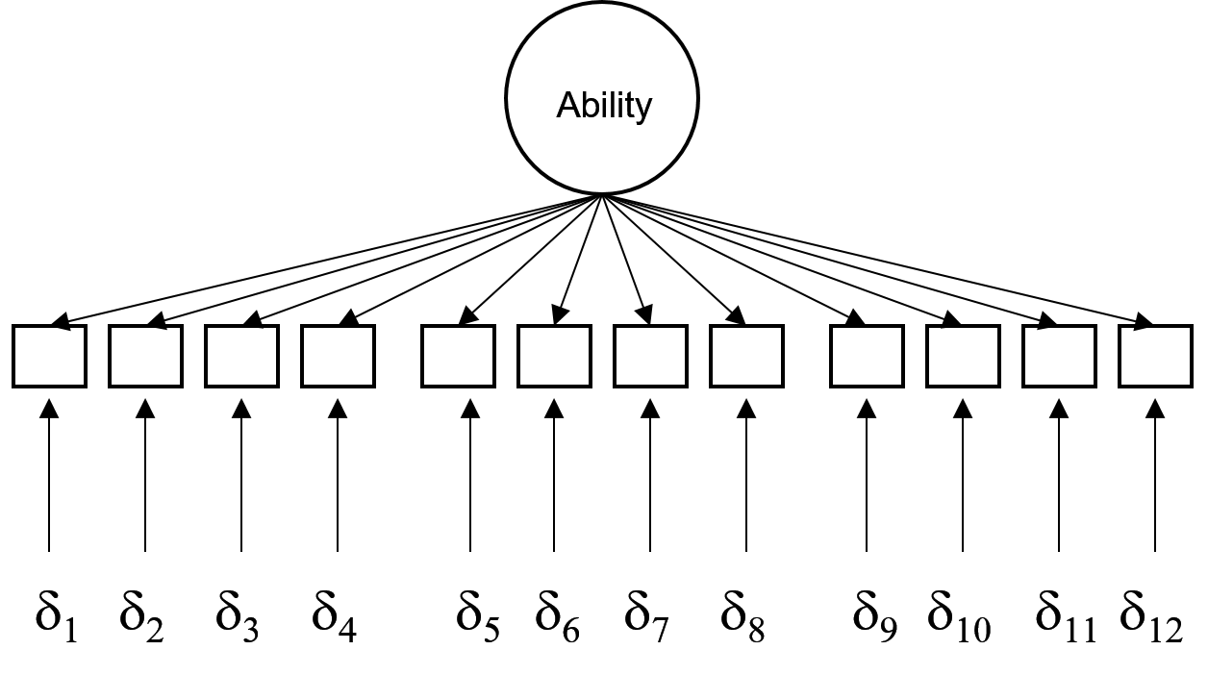
The substantially different fit is evident in the goodness-of-fit indices.

Slide 37
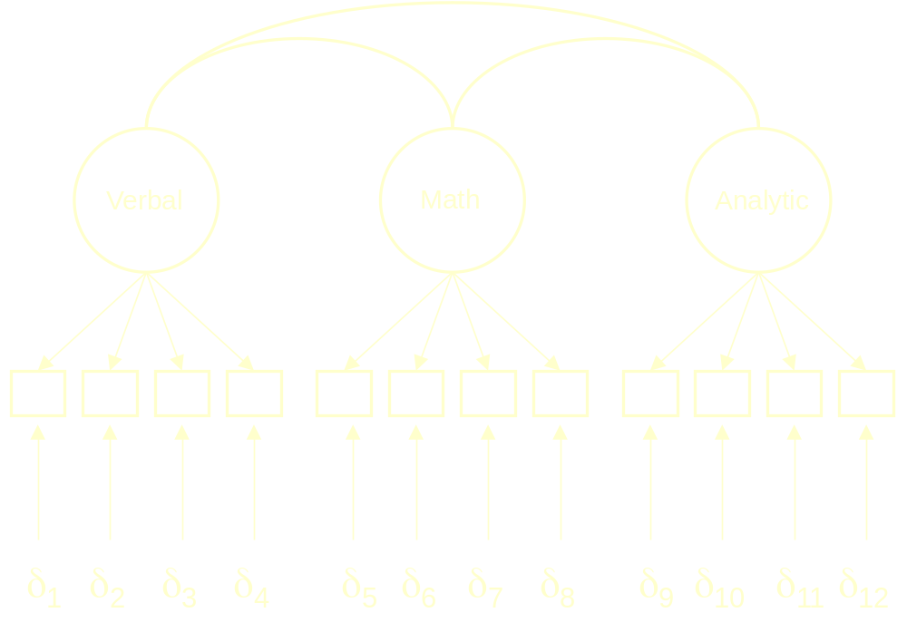
Can the latent variable correlations be set equal?

Slide 38
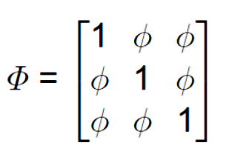

Slide 39
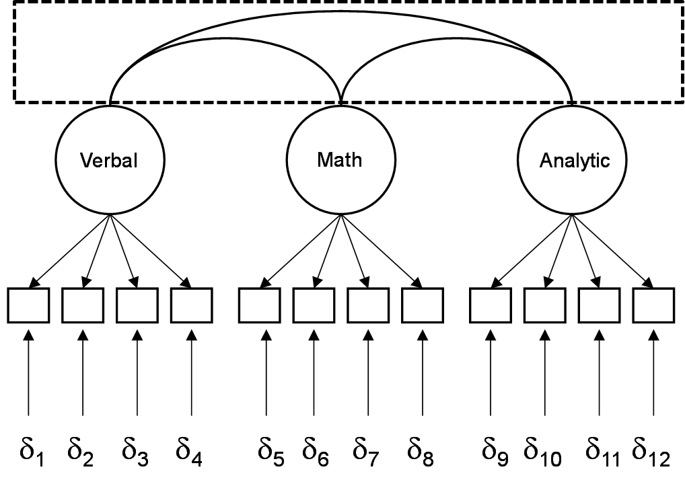
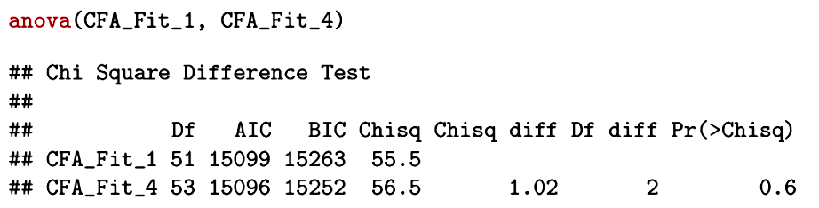
This model is indistinguishable from the original.

Slide 40
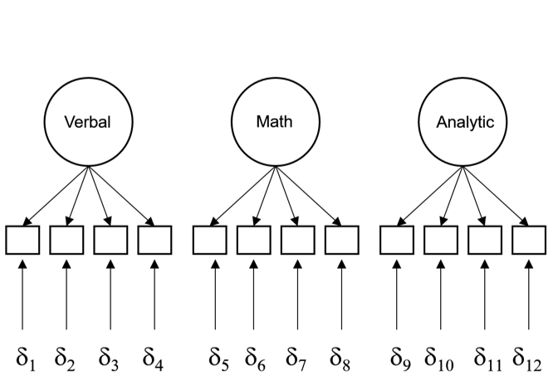
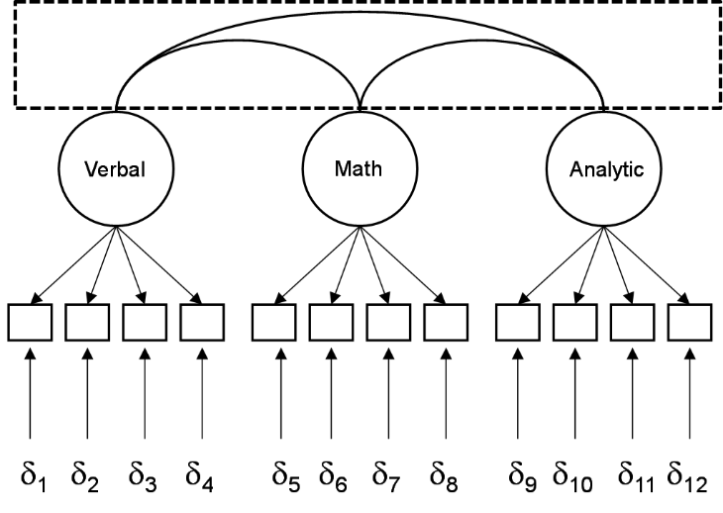
X
X
Of the four alternatives, two are worse fits than the original. Of the two viable models, the last is the most parsimonious.

Slide 41
Next time . . .
  Scaling of latent variables
  Correlation versus covariance matrices
  Model modification (“exploratory” confirmatory factor analysis)
  Relation to measurement theory
  Measurement invariance (cross-validation)

